Slide 1
Structuring the Watershed Plan’s Priorities and Schedule
Jason doll, CPSWQ
Senior Scientist
Notes:
Now that the watershed is fully characterized and various management techniques have been identified, the watershed management plan can be drafted. This section will explain how to put all of the pieces together, plan for implementation, and develop an implementation schedule.

Slide 2
Develop a Monitoring Program
Used to
Ensure plan is effective
Ensure appropriate reduction techniques were used
Milestones are being met
Schedule is on track
Quantitative, numerical data should be measured
Can use
Pre-existing water quality monitoring stations
Design new sampling stations
 | Indicator | Measured by
1 | Water quality parameter (ex: fecal coliform count) | Comparing numerical before and after measurements of the water quality indicator
2 | Stormwater Runoff Volume | Applying stormwater reduction techniques and determining how much stormwater is reduced by the techniques as each new project is installed
Example
Notes:
A monitoring program should be developed to ensure that the plan is effective, milestones are being met and that the plan is on track. Quantitative, numerical monitoring data should be used as a primary measure of improved water quality. Numerical, measureable data of a water quality indicators is necessary to ensure that the appropriate stormwater reduction techniques were used to reduce the volume of stormwater entering surface waters of the watershed. Pre-existing monitoring programs can provide current and future measurements and historic water quality measurements. If it is necessary to develop a monitoring program to address the goals and objectives of the watershed management plan.

Slide 3
Establish Evaluation Criteria
Criteria to evaluate progress towards meeting watershed objectives
Why
Improve effectivness of plan
Improve quality of plan
Meets needs of community
Evaluation | Indicator
Mid-course evaluation | Conduct full assessment of plan
Education and Outreach Evaluation | Full evaluation of Education and Outreach success
Example
Notes:
One of the nine EPA’s key elements for a watershed management plan is to establish criteria with which to evaluate progress toward meeting watershed goals. This simply means that projects and activities should demonstrate advancement of the primary goal and should be evaluated to improve efficiency and quality. The key to developing evaluation programs is to ensure that the evaluation utilizes a before-and-after comparison approach. Regular evaluations ensure that the plan continues to meet the needs of the watershed and the community. Evaluations should focus on determining the effectiveness of the plan.

Slide 4
Establish Milestones
Show progress through the life of the plan
Specific, measurable and achievable
Examples
# gallons reduced
# shellfish harvesting areas reopened
# acres no longer impaired
# community members educated
Notes:
interim, measurable milestones for determining whether management measures are helping to achieve goals. A milestone in this context can be seen as an action that shows progression through the life of the plan. These are generally achievements that will show the community and the stakeholders that actions are being implemented and having an effect. It is important to develop milestones that are specific, measureable and achievable.

Slide 5
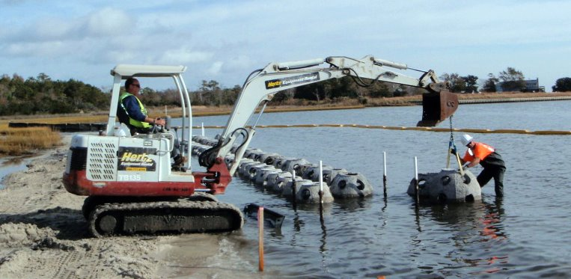
Implementation Budget
Consider
Permitting Fees
Staffing and Labor
Equipment
Education Activities
Maintenance
Outsourced Work
Identify Technical Needs
Identify Funding Resources and Opportunities
Notes:
A critical component of plan implementation is a well-developed budget. The project budget may not perfectly reflect actual costs associated with the plan, but is necessary for defining the scope of the project and is often a required component when applying for funding and grants
In conjunction with cost estimates, consider the necessary technical assistance needed for the monitoring. Partners may be able to provide technical assistance in the form of: project implementation and management tools, education and outreach material, monitoring data, training material and data management
Funding is can predicate the scope of implementation plans. Utilizing this guidebook will help to ensure that all necessary elements are included to better position communities to qualify for consideration when applying for funding. As with any grant, funding is not guaranteed or may not cover all project expenses. Consider researching funding possibilities and the federal, state and local levels.

Slide 6
Implementation Schedule
Include
Each actions that needs to be completed
Partner who is responsible for completing the action
Time frame to complete the action
Maintenance schedule
Cost
Funding source
Indicator of success
Notes:
An important component to the success of a management plan is developing an implementation schedule. The schedule will lay out a detailed plan for meeting the goals and objectives of watershed restoration. In order to develop a successful implementation schedule, consider incorporating the following elements:
Actions that needs to be completed;
Partner who is responsible for completing the actions;
Time frame to complete the action;
Maintenance schedule;
Cost;
Funding source;
Indicator of success.
These elements can ensure that plans are encompassing and thorough. Addressing all of these elements shows management and foresight regarding the project and the work necessary, which can be beneficial when applying for funding. When developing a specific action, keep in mind the milestones and ultimate goals that have been outlined for the restoration plan.

Slide 7
Primary Goal: Reduce stormwater runoff volume to restore water quality Objective 3 Reduce the transport of bacteria from land to water by reducing the volume of stormwater runoff.
Action | Partner | Time | Maintenance Schedule | Cost | Funding Source | Indicator
Action 1: Install downspout retrofits at public buildings with educational signage
Install downspout retrofits at public buildings | Town Hall | Year 3 | Once a year, check for wear. Include as part of building’s regular inspections | $1,000; installed by volunteers | Town Hall | # of 23 retrofits installed
Install Education signage for downspout retrofits | Town Hall | Year 3 | Once a year, check for wear. Include as part of building’s regular inspections | $1,000; designed and installed by contractor | Grant | # of 5 signs installed at: Town Hall Library Com Center Park 1 Park 2
Notes:
Example Project Implementation schedule

Slide 8
Draft the Plan
Watershed Management Plan Writing Template
Executive Summary
Introduction
Watershed Description
Watershed Conditions
Runoff Volume Reduction
Goals
Management Strategies
Implementation Program
Notes:
The key to an effective watershed management plan is to keep the plan realistic. Given available resources, the plan should indicate plausible solutions that are citizen-focused and partnership-based. A comprehensive plan will address all the possible stormwater runoff inputs and take into consideration the varying range of conditions found within the watershed. It is important that the plan be specific on volume reduction targets and management goals. To aid in the plan writing process, utilize the Watershed Management Plan Writing Template designed to be used in conjunction with this guidebook.
The Template was designed to provide examples, suggestions and ideas given are intended to aid in the brainstorming and development process. This guidance is not a substitution for mandatory statues or regulations by federal, state or local agencies.
Open and explore Template in word with Audience?

Slide 9
Questions
Jason doll, CPSWQ
Senior Scientist

